Slide 1

Full Board Meeting
Friday, May 26th
Sally Fox Conference Center, Waterbury State Office Complex
Victoria Biondolillo
Executive Director
Adam Grinold
Chair
Abigail Rhim
Deputy Director

Slide 2
Full Board Meeting Agenda
May 26, 2023
8:30 am – 1:00 pm
Sally Fox Conference Center, Waterbury State Office Complex, Cherry A/B/C
8:30 am Registration & Networking Breakfast
9:00 am Call to Order, Approval of Minutes and Welcoming Remarks
9:15 am Guest Presentations
      Major General Gregory Knight, Vermont Adjutant General, Vermont National Guard
      Rhoni Basden, Executive Director and Alison Lamagna, Director of Impact Vermont Works for Women
10:15 am Break
10:30 am Strategic Plan Review
12:20 pm Vote
12:30 pm Adjourn/Optional Lunch

Slide 3
VTARNG: As of October 1, 2022
UNIT | AUTH | ASSN | DELTA
VTARNG | 2552 | 1959 | 593
JFHQ | 212 | 247 | (35)
124th RTI | 192 | 165 | 27
186th IBCT (MTN) | 1752 | 1185 | 567
GSC | 396 | 362 | 34
Top Army vacancies by MOS (as of April 1, 2023): There are currently 509 vacancies in just our top 10 short MOSs. This shows that the overall vacancies are higher in general than the ‘delta’ of assigned shown above. We tend to stack people at JFHQ as they rise in rank (also shown in the higher assigned strength for JFHQ) but are not replacing them at the lower levels. NGB cares mostly about paid strength, but our ability to fulfill missions is impacted more by the vacancies than the end strength.
11B (Infantry) - 324 slots available/ 163 vacant
19D (Calvary) - 148 slots available/ 63 vacant
68W (Medic) - 170 slots available/ 67 vacant
91B (Wheeled Vehicle Mechanic) - 114 slots available/ 42 vacant
92A (Automated Logistics) - 79 slots available/ 38 vacant
25U (Signal) - 47 slots available/ 32 vacant
92Y (Unit Supply Specialist) - 77 slots available/ 31 vacant
92G (Food Service) - 56 slots available/ 27 vacant
92F (Petroleum Supply) - 39 slots available/ 24 vacant
11C (Mortars) - 49 slots available/e 22 vacant

Slide 4
VTANG: As of May 1, 2023
UNIT | AUTH | ASSN | DELTA
VTANG | 1161 | 1001 | 160
JFHQ | 31 | 30 | 1
158 FW | 49 | 43 | 6
158 OG | 11 | 8 | 3
134 FS | 31 | 26 | 5
158 OSS | 47 | 41 | 6
158 MXG | 32 | 21 | 11
158 AMXS | 243 | 214 | 29
158 MOF | 22 | 18 | 4
158 MXS | 184 | 150 | 34
158 MDG | 64 | 66 | (2)
158 MSG | 15 | 10 | 5
158 CES | 98 | 93 | 5
158 CF | 41 | 42 | (1)
158 LRS | 84 | 70 | 14
158 FSF | 38 | 45 | (7)
158 SFS | 81 | 80 | 1
158 CPTF | 12 | 13 | (1)
229 COS | 71 | 37 | 34
Discrepancy | 1154 | 1007 | 158
Using the Strength report, minor discrepancies exist potentially from AFSC mismatches, or MCR changes.
Top Air National Guard vacancies by AFSC (As of May 1, 2023): There are currently 86 vacancies in our top 6
enlisted career fields that need to be filled.
2W0X1 (Munitions Systems) - 69 slots available/ 23 vacant
2W1X1 (Aircraft Armament Systems) - 62 slots available/ 17 vacant
1B4X1 (Cyber Warfare Operations) - 33 slots available/ 24 vacant
1P0X1 (Aircrew Flight Equipment) - 12 slots available/ 11 vacant
2A6X3 (Aircraft Egress Systems) - 15 slots/ 5 vacant
2F0X1 (Fuels) - 16 slots/ 6 vacant

Slide 5
Additional Benefits of Membership:
Education – College tuition benefits, ROTC
Training – Military Occupational Specialty/ Air Force Specialty Code (MOS/AFSC) Training aligns with many civilian jobs
Desirable Skills – attention to detail, discipline, planning organization, communication
Leader Development – the Vermont National Guard is a leader development program from the first day
Healthcare – Tricare Reserve Select
How Can You Help:
Help build a marketing program to educate our recruiting demographic on the benefits of serving in the VTNG (Think Vermont website, National Guard Employment Network)
Expand our outreach to active-duty installations, focusing on making Vermont a destination for prior service members
Facilitate the VTNG/Employer network, supporting employers who hire VTNG members
Bring the whole of Vermont approach to recruiting for the VTNG – think workforce development
Help tell the Guard story and educate centers of influence (legislators, educators, business leaders

Slide 6


Slide 7


Slide 8


Slide 9
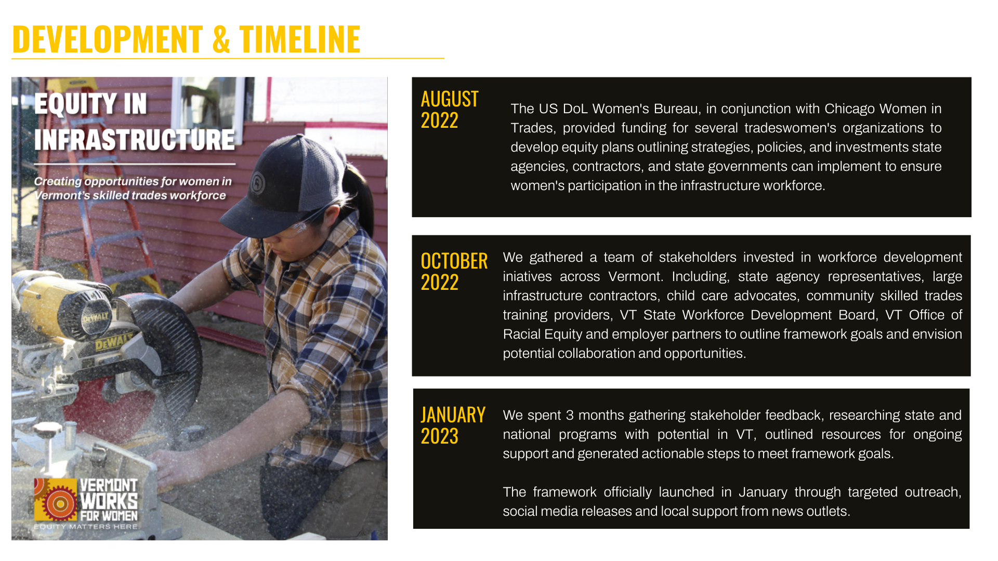

Slide 10


Slide 11
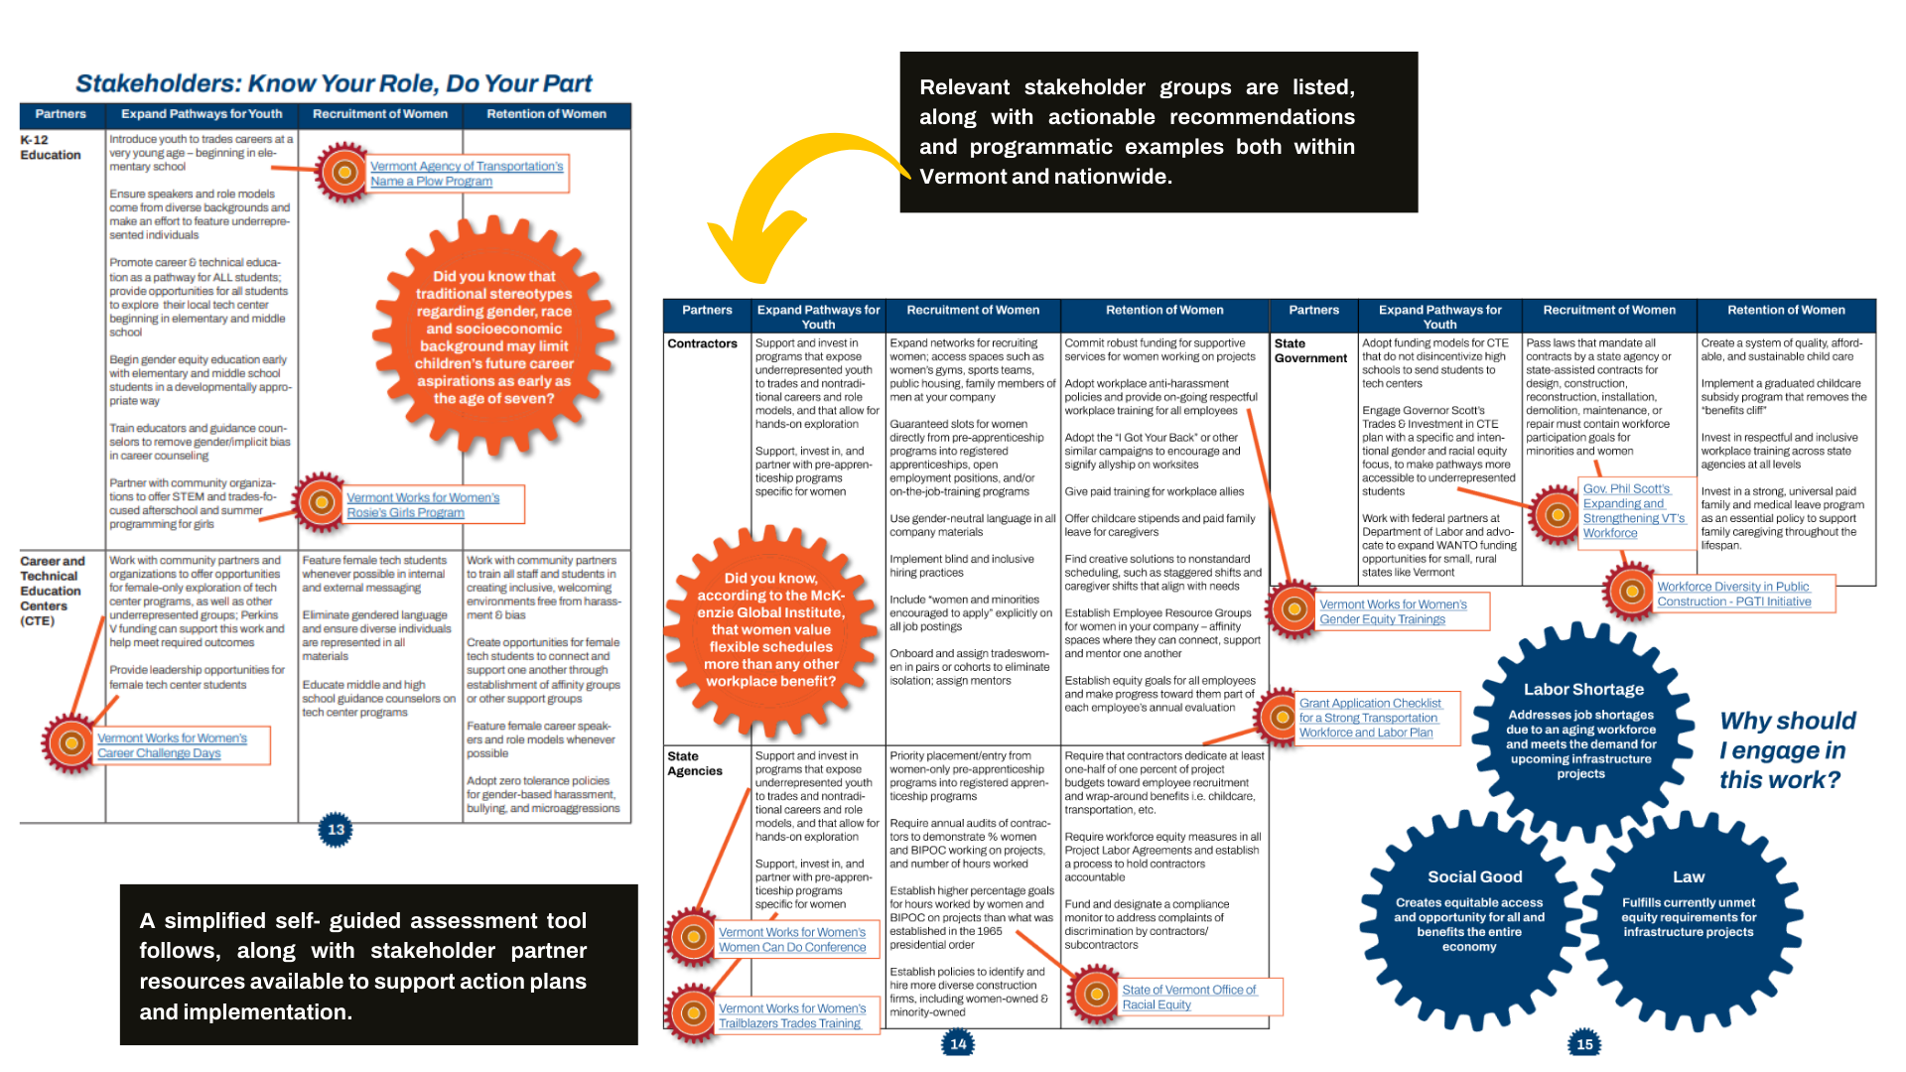

Slide 12
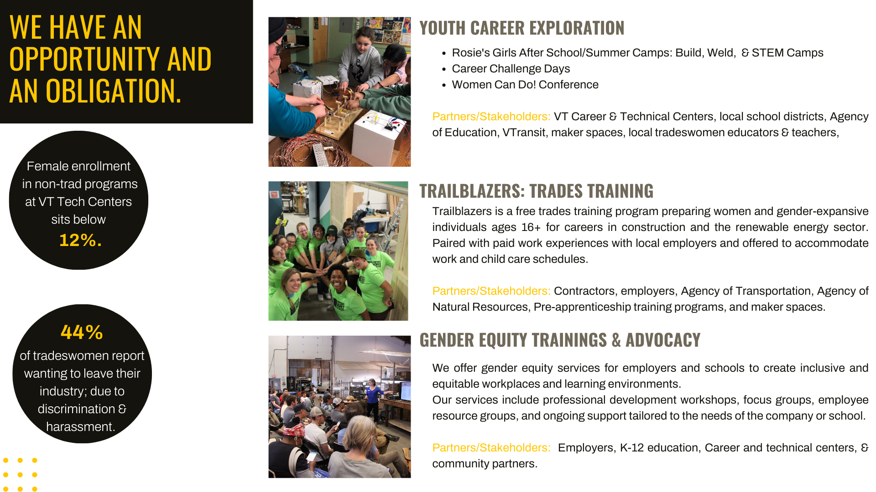

Slide 13

Rhoni Basden, Executive Director
rbasden@vtworksforwomen.org
Alison Lamagna, Director of Impact
alamagna@vtworksforwomen.org
www.vtworksforwomen.org

Slide 14
Break
10:15 – 10:30 am

Slide 15
Strategic Plan - Timeline
Phase One: Setting the Stage May 2022 – September 2022 | Operating Committee Strategic Plan Meeting #1 – 5/12/22 Board Meeting – 5/26/22 Operating Committee Strategic Plan Meeting #2 – 6/27/22
Phase Two: Framing and Review October 2022 – December 2022 | Operating Committee Strategic Plan Meeting #3 – 9/23/22 Open forum working session Board Meeting – 10/6/22
Phase Three: Plan Development and Refinement January 2023 – April 2023 | Operating Committee Strategic Plan Meeting #4 – 1/17/23 Operating Committee Strategic Plan Meeting #5 – 2/2/23 Vote to approve strategies Board Meeting – 2/13/23 Vote to approve strategies Strategic Plan Working Groups, Committee Meetings and Weekly SWDB Staff Office Hours – March through May Operating Committee – 4/21/23 Final strategic plan edits
Phase Four: Final Approval May 2023 | Committee Meetings – March through May Individual committees vote to approve portions of strategic plan Operating Committee – 5/15/23 Vote to approve full strategic plan Board Meeting – 5/26/23 Vote to approve full strategic plan (in person!)
We are here!
Notes:
-this has been a culmination of work over the past 10 months, great working with everyone in committee meetings and individually
-NGA met with us in May of 2022
-multiple meetings with the Operating Committee to finalize these details, in our last meeting, they voted to approve the strategies that we are discussing today
-today we are running through the top priorities and their discussed strategies, we will then focus on building out the details and operational planning in the coming months
-goal is to finish this plan by end of May, what a finished product looks like will include....
-emphasize the many opportunities to provide feedback***
-give credit to members and Adam for developing planning, their collective vision

Slide 16
SWDB Committees + Strategic Plan Working Groups
SWDB Committees
Agriculture
Career Pathways
Health Care Workforce Strategic Plan Advisory Group
Hospitality and Retail
Manufacturing
Operating
Policy
Relocation and Recruitment
Training and Credentialing
Youth
SWDB Working Groups
Workforce Innovation and Opportunity Act (WIOA) - 4/4/23
Workforce System Alignment – 4/12/23
Workforce Supports – 3/31/23
Workforce Education and Training –4/7/23
Size and Quality of Workforce –4/10/23

Slide 17
Table of Contents
Letter from the Governor
Letter from the Chair and Executive Director
The State of Play
Vision, mission, goals, approach
Workforce Innovation and Opportunity Act (WIOA)
Workforce System Alignment
Workforce Supports
Workforce Education and Training
Size and Quality of Workforce
Committees
Career Pathways
Appendix
The Plan
Agriculture
Health Care Workforce Development Strategic Plan Advisory Group
Hospitality and Retail
Manufacturing
Relocation and Recruitment
Training and Credentialing
Youth
Notes:
-emphasize how many opportunities the group has to give opinion
-remind group that when we first took over, everyone was clear that the board needed clearly direction, this plan is a culmination of your thoughts and ideas to help move the board role in moving forward in the workforce system

Slide 18
State of Play
Challenge:
Average daily loss of six workers out of workforce and three children out of schools
Peak labor force in mid-2000s, decline in workforce population in every county since, exacerbated by COVID-19 pandemic
Must reduce barriers for those already here and connect with those who aren't
Opportunities:
Lots of good work happening in Vermont and great "product" to sell
Need a unified vision for all partners currently focused on issues in order to propel state towards goals
Call to Action:
Charged as the convenor and coordinator of Vermont's workforce system, these issue areas have been crafted to name specific action items that the SWDB can and will be held accountable for

Slide 19
State of Play
Vision: Vermont’s employment demands will be met through a statewide, coordinated, and integrated system of workforce education, training, and development where Vermonters can connect to robust career pathways, advance along career ladders, and new Vermonters can quickly secure employment with a Vermont employer.
Mission: To develop and implement a comprehensive, coordinated, and responsive statewide workforce education and training system.

Slide 20
State of Play
Approach:
Collect information from all stakeholders
Formulate a general framework of principles
Gain consensus on top strategies for the Board
Utilize working groups, email feedback, one-on-one meetings, and stakeholder engagement to identify details for plan execution
Edit, collect input, repeat
Finalize a clear roadmap for Board success.

Slide 21
Priority Areas
Workforce Innovation and Opportunity Act (WIOA)
Workforce System Alignment
Workforce Supports
Workforce Education and Training
Size and Quality of Workforce
Notes:
WIOA: our main charge and focus. We receive millions of dollars in federal funding each year. You've asked for more oversight. Meat and potatoes of our workforce funding...maximise this to help as many vulnerable people as possible.
Alignment: In our initial meeting partners talked about duplicate efforts, and coordination – fulfilling our charge as a coordinator this was an important focus for each of us.
Workforce supports: recognizing that workforce is more than just about the policies for training and recruitment but how we support folks in other ways.
Cradle-to-career
Ultimately we do not have enough people here to sustain job growth we need to focus our efforts on growing the talent pool not just training our existing workforce.

Slide 22
Area | Strategy | Select Milestones
Workforce Innovation and Opportunity Act (WIOA) | 1.1 Develop, Implement, and Modify WIOA State Plan | The SWDB Policy Committee will review yearly WIOA reporting and provide guidance on corrective measures by January 2025 to increase service utilization by no less than 20%.
 | 1.2 Select One-Stop Operator and Monitor System Improvement | By July 2023, the One-Stop Operator will be selected.
 | 1.3 Create and Apply State Performance Accountability Measures | By March 2026, the Policy Committee will produce a report on metrics to be evaluated by the full SWDB. The SWDB will provide recommendations for areas of improvement with a corrective action plan and potential consequences with agreed upon deadlines.
Workforce System Alignment | 2.1 Create and Implement a Warm Handoff System | By January 2024, the SWDB staff and One-Stop Operator will have distributed the updated common intake form, with established KPIs to track effectiveness, to all applicable service locations (both physical and virtual) and provide training to staff on form updates.
 | 2.2 Foster and Maintain Regional Business Partnerships | By January 2024, board members will review summary county visit employer reports compiled by the SWDB staff and provide actionable feedback.
 | 2.3 Expand Workforce Services to Marginalized Groups | By December 2024, the SWDB staff will host at least four events related to promoting workforce services to marginalized groups.
Workforce Supports | 3.1 Solicit and Apply Workforce Board Policy Input | By FY2026 budgeting deadline, the Policy Committee will recommend workforce policy to the Governor’s office that clearly outlines each policies contribution to net new workers per year.
 | 3.2 Implement Language Accessibility Plan for Workforce Related Materials | The SWDB will produce translated materials to partners and program providers.
Workforce Education and Training | 4.1 Map Career Pathways (Career Pathways Committee) | By January 2024, the Career Pathways Committee will begin its annual career pathways approval process.
 | 4.2 Host Education and Training Provider Round Tables | By December 2024, the SWDB will host no less than two convenings of education, training, and workforce support providers.
 | 4.3 Define Eligibility and Approve Credentials of Value (Training and Credentialing Committee) | By June 2024, the Training and Credentialing Committee will officially begin involvement reviewing eligible training providers and credentials of value.
Size and Quality of Workforce | 5.1 Facilitate Collaboration and Effective Recruitment and Retention Strategies | By December 2025, the SWDB’S Relocation and Recruitment Committee meets twice with community partners to identify system holes to attract more than 5,000 new workers per year by 2040.
 | 5.2 Increase Marginalized Populations’ Participation in the Workforce | By December 2025, the SWDB and Racial Equity Task Force host a joint convening.
 | 5.3 Develop Statewide New American Support Network (Pending Legislative Approval) | By November 2025, the SWDB will launch the New American Relocation Network to attract and retain refugees and immigrants who come to Vermont.
 | 5.4 Increase Labor Force Participation Rate | By August 2023, the Policy Committee will provide strategies to add at least 2,000 disengaged workers back into our workforce per year.

Slide 23
Workforce Innovation and Opportunity Act (WIOA)
In keeping with WIOA, the SWDB will remain in compliance regarding federal requirements.
1.1 Develop, Implement, and Modify WIOA State Plan
1.2 Select One-Stop Operator and Monitor System Improvement
1.3 Create and Apply State Performance Accountability Measures

Slide 24
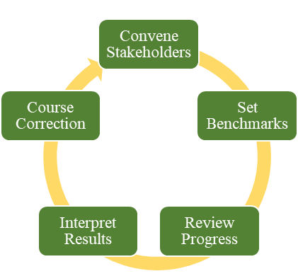
1.1 Develop, Implement, and Modify WIOA State Plan
Purpose: Fulfill federal obligation while making Combined State Plan a useful tool for moving the needle on our workforce goals.
SWDB Action:
Review of One-Stop partners' performance compared to goals outlined in Combined State Plan
Provide feedback and suggest corrective measures for underperforming entities or One-Stop partners
Report and assess progress on WIOA programs' contribution to overall state goals

Slide 25
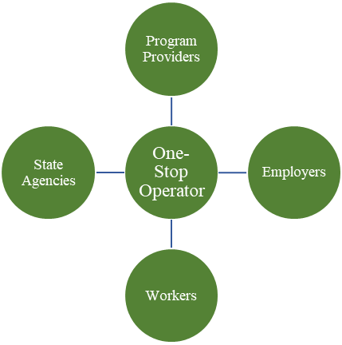
1.2 Select One-Stop Operator and Monitor System Improvement
Purpose: Fulfill federal requirement while coordinating WIOA partners to maximum potential.
SWDB action:
Approval of selected One-Stop Operator
Performance monitoring of One-Stop System
Evaluate vendor effectiveness in managing One-Stop System

Slide 26
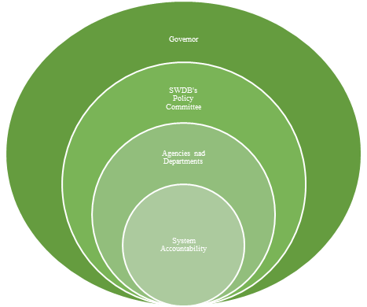
1.3 Create and Apply State Performance Accountability Measures
Purpose: Evaluation of program effectiveness to hold all partners accountable to agreed upon outcomes.
SWDB Action:
SWDB's Policy Committee identifies most relevant performance accountability metrics and success benchmarks
Quarterly evaluation of One-Stop partners
Goal setting and corrective measures to improve performance

Slide 27
Next Steps
Operating Committee will meet to review One-Stop Operator Bids.
SWDB's Policy Committee to begin meeting and discussing performance accountability measures.

Slide 28
Workforce System Alignment
Improve Vermont’s workforce development system by increasing coordination, integration, and tracking of support services to meet the needs of all Vermonters throughout their lifespan.
2.1 Create and Implement a Warm Handoff System
2.2 Foster and Maintain Regional Business Partnerships
2.3 Expand Workforce Services to Marginalized Groups

Slide 29
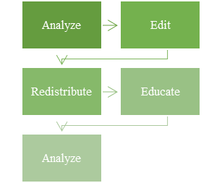
2.1 Create and Implement a Warm Handoff System
Purpose: Improve service delivery to Vermonters.
SWDB Action:
Convene One-Stop Partners
Development of new referral model with One-Stop Operator
Determination of Key Performance Indicators
Evaluate performance and results

Slide 30
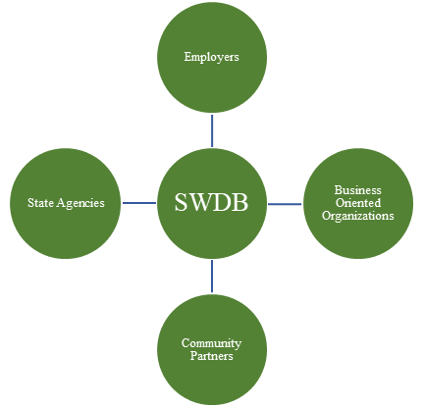
2.2 Foster and Maintain Regional Business Partnerships
Purpose: Get feedback from regional businesses on how our system can support their needs.
SWDB Action:
Convene partners and businesses
Assess information
Turn data into actionable policy recommendations

Slide 31
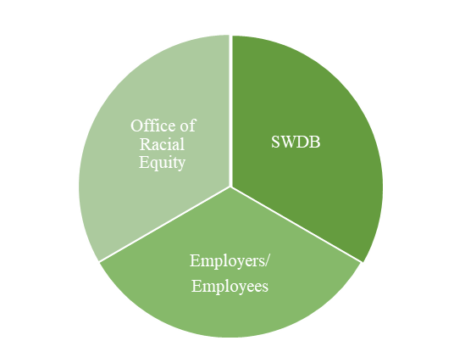
2.3 Expand Workforce Services to Marginalized Groups
Purpose: Increase program participation and service delivery to marginalized populations.
SWDB Action:
Host and attend radar meetings with the Office of Racial Equity.
Direct outreach to populations needing additional support

Slide 32
Next Steps
Receive county visit schedule and meeting summary reports.
Following the selection of the One-Stop Operating by mid-summer, convenings among partners to develop warm hand off system begin.

Slide 33
Workforce Supports
Improve awareness and utilization of current workforce resources while also addressing external workforce barriers like affordability of housing, childcare, internet access, and more which additionally must be considered to better enhance workforce growth.
3.1 Solicit and Apply Workforce Board Policy Input
3.2 Implement Language Accessibility Plan for Workforce Related Materials

Slide 34
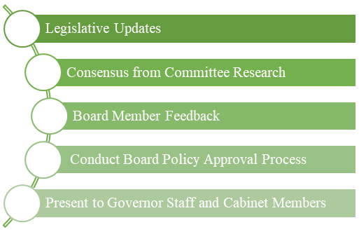
3.1 Solicit and Apply Workforce Board Policy Input
Purpose: Create a clear role for the Board in the policy development process.
SWDB Action:
Provide feedback on legislative updates
Committees research and provide best practices and ideas for Board consideration
Present suite of policy recommendations to the Governor's office as it relates to workforce development

Slide 35

3.2 Implement Language Accessibility Plan for Workforce Related Materials
Purpose: Create easily navigable documents for workers and employers and ensuring accessibility to individuals of all backgrounds.
SWDB Action:
Compilation of Vermont resources
Development of toolkits for employers and employees
Providing recourses to translation vendor as selected from the Office of Racial Equity
Publicity of resources to Vermont communities

Slide 36
Next Steps
Starting in August, the Policy Committee will begin meeting regularly to discuss priorities. This will include sector-based committee input.
This summer, the SWDB staff will compile resources for employee and employer toolkits which will eventually be translated.

Slide 37
Workforce Education and Training
Identify Vermont’s high-demand careers and develop career pathways to be seamlessly executed by training and education providers while engaging Vermonters at any stage of their career path, leading to greater financial independence and personal fulfillment.
4.1 Map Career Pathways (Career Pathways Committee)
4.2 Host Education and Training Provider Round Tables
4.3 Define Eligibility and Approve Credentials of Value (Training and Credentialing Committee)

Slide 38
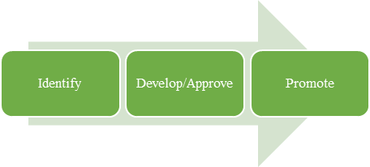
4.1 Map Career Pathways
(Career Pathways Committee)
Purpose: Provide clarity for all Vermonters on pathways to success.
SWDB Action:
Review of work formally done by the Career Pathways Committee
Develop new approval process for determining career pathways based on in-demand careers
Market and promote career pathways to Vermonters

Slide 39
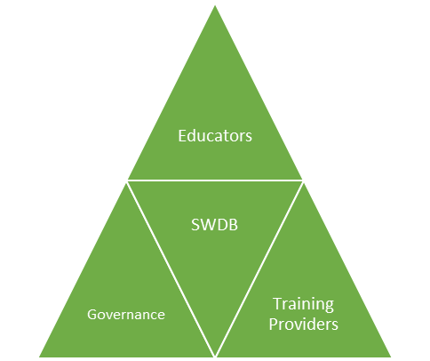
4.2 Host Education and Training Provider Round Tables
Purpose: Increase collaborative opportunities for education and training providers in and outside of the K-12 space.
SWDB Action:
Host no less than two meetings per year
Summarize and review findings from these events
Determine appropriate recommendations for improvement

Slide 40
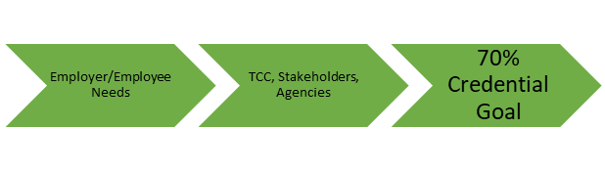
4.3 Define Eligibility and Approve Credentials of Value
(Training and Credentialing Committee)
Purpose: Create consistency in the approval and promotion of credentials of value, while using employer demand to determine gaps in credentials needed for Vermont jobs.
SWDB Action:
Reviewing previous work done by the Training and Credentialling Committee prior to the pandemic
Regular convening of the TCC to review and approve credentials of value
Utilizing data and employer demand to determine where more credentials are needed

Slide 41
Next Steps
The Career Pathways Committee will start to review the existing approval process of career pathways.
The Training and Credentialing Committee will begin reviewing the findings of the 2019, Training and Credentialing Working Group.
The SWDB staff will begin initial planning for the 2024 education and training provider round tables.

Slide 42
Size and Quality of Workforce
Work to better identify, strengthen, and coordinate Vermont’s relocation and recruitment system with the guiding objective of net-new workers to grow Vermont’s workforce.
5.1 Facilitate Collaboration and Effective Recruitment and Retention Strategies
5.2 Increase Marginalized Populations' Participation in the Workforce
5.3 Develop Statewide New American Support Network
5.4 Increase Labor Force Participation Rate

Slide 43
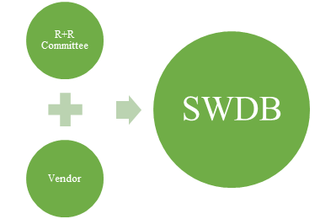
5.1 Facilitate Collaboration and Effective Recruitment and Retention Strategies
Purpose: Provide coordination to the many different entities working to recruit new Vermonters to the state.
SWDB Action:
Needs assessment
Partner inventory
Utilizing findings from New American Support Network vendor
MOU between relocation partners to formalize communications

Slide 44

5.2 Increase Marginalized Populations' Participation in the Workforce
Purpose: Gain more diversity in the State Of Vermont's workforce.
SWDB Action:
Provide awareness of opportunities
Host trainings
SWDB joint meeting with the Racial Equity Task Force

Slide 45
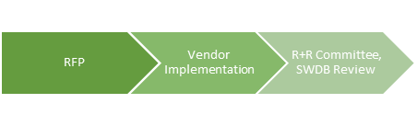
5.3 Develop Statewide New American Support Network
Purpose: Create an easily navigable system to relocate New Americans to Vermont.
SWDB Action:
Vendor Selection
Connecting vendor to relevant stakeholders
Collecting information
Reviewing vendor recommendations
Promotion of system

Slide 46
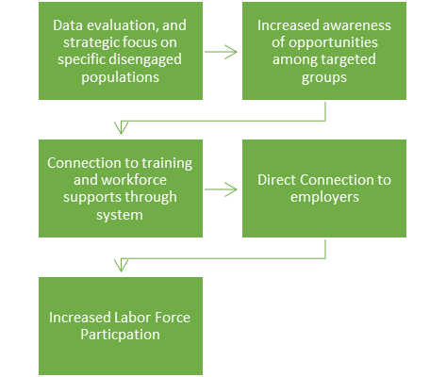
5.4 Increase Labor Force Participation Rate
Purpose: Increase size of labor force in Vermont by brining disengaged workers back into the workforce.
SWDB Action:
Review data on populations falling behind in labor force participation and unemployment
Develop and recommend strategies to specifically assist these populations

Slide 47
Next Steps
The Relocation and Recruitment Committee will work with the SWDB staff to develop an RFP and select a vendor to oversee the New American Support Network.
The Policy Committee will convene regularly to discuss strategies to address labor force participation rates of disengaged populations
The SWDB staff will continue to meet with the Office of Racial Equity regularly and begin planning radar meetings.

Slide 48
Things to Look For
Official strategic plan release email
Committees' summer meeting schedule
County tour schedule with update reports
Continued Friday office hours
End of summer recap on strategic plan progress
By-Law Changes

Slide 49
Questions?

Slide 50
Vote of Approval

Slide 51
Thank You!
Victoria Biondolillo
Executive Director
victoria.biondolillo@vermont.gov
Adam Grinold
Chair
agrinold@brattleborodevelopment.com
Abigail Rhim
Deputy Director
abby.rhim@vermont.gov

