Slide 1
WIOA State
Plan Update
February 20, 2020

Slide 2
Today’s Focus
Purpose
Plan
Picture
Part

Slide 3
Purpose
Four-year strategic plan of the workforce development system
Fosters the development of a comprehensive and integrated approach to address needs of businesses and workers in Vermont
Working across agencies to leverage resources
Drives funding, resources, and allowable activities
Notes:
The WIOA State Plan must be completed for Core Programs to receive funding. The national workforce development system is comprised of federal, state, regional and local agencies and organizations.
With all these resources, comprehensive range of services can be provided through workforce development to serve the two customers of services: businesses and job seekers.
These services include employment, education job training and all related services to help job-seekers secure good jobs while simultaneously serving businesses with skilled workers that enable them to compete in the local, national and global economic market.

Slide 4
Vision
“Vermont’s employment demands will be met through a statewide, coordinated, and integrated system of workforce education, training, and development where all Vermonters, including new Vermonters, can connect to robust career pathways, advance along career ladders, and quickly secure employment with a Vermont employer.”

Slide 5
Goals
Goal 1: Connect Vermonters to services
Goal 2: Increase the number of underrepresented people employed in priority industry
Goal 3: Increase the number of Vermonters with barriers with employers.
Goal 4: Improve Vermont’s workforce development systme
Goal 5: Expand Vermont’s labor force
Notes:
Goal 1: Connect Vermonters to the education, training, and supportive services needed to enter and advance along a career pathway that leads to greater financial independence.
Goal 2: Increase the number of women, minorities, people with disabilities, and other underrepresented people employed in the skilled trades, science, technology, engineering, and mathematics fields, advanced manufacturing, and other priority industry sectors in Vermont.
Goal 3: Increase the number of Vermonters with barriers to employment who complete high school, earn a post-secondary credential - including an industry-recognized certificate, registered apprenticeship, or post-secondary degree program - and become employed in occupations that align with the needs of Vermont’s employers.
Goal 4: Improve Vermont’s workforce development system by continuously aligning, adapting, and integrating workforce education and training programs and career and supportive services to meet the needs of all participants.
Goal 5: Expand Vermont’s labor force by helping more Vermonters enter the labor market and assisting out-of-state workers in securing employment with Vermont employers and relocating to Vermont.

Slide 6
Plan Components
Type
  Unified v. Combined (JVSG and TAA)
Strategic Elements
  Vision, Goals and Strategy
Operational Planning Elements
  Implementation Strategy, Systems and Policies
Coordination with Combined State Plan Programs
  Methods of Coordination
Common Assurances
Program-specific Requirements for Core Programs
  Programmatic Details
Program-specific Requirements for Combined Programs
  Additional Programmatic Details

Slide 7
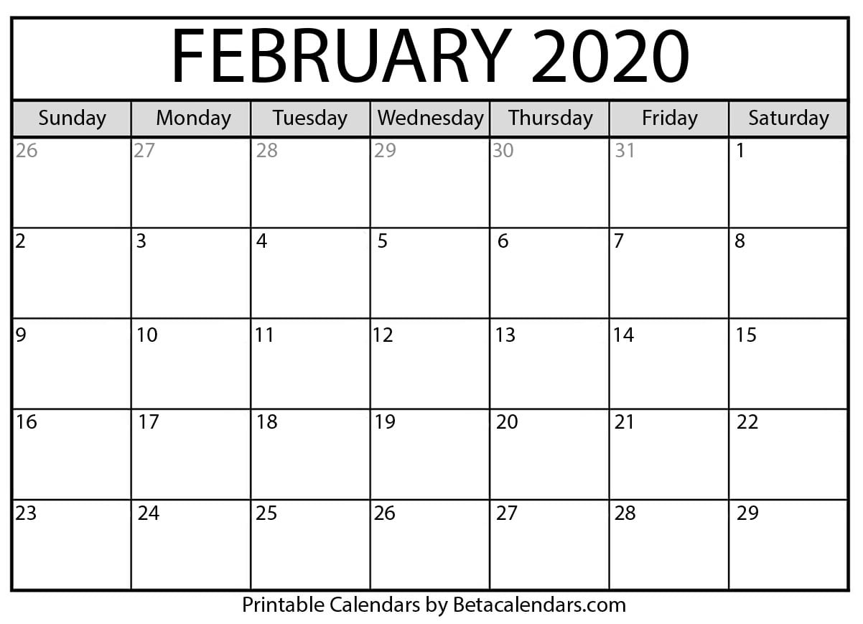
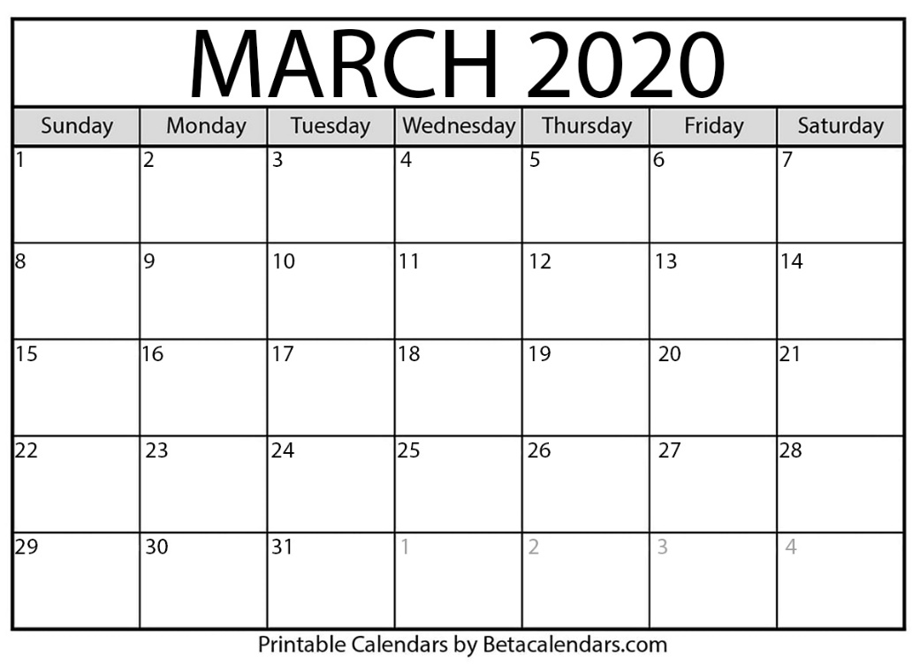
Timeline
First Full Draft of Plan Complete: March 6
Public Comment Period: March 4 - 18
Review Comments and Incorporate Into Plan: March 19 - 25
Enter Final Version of Plan into Portal: March 26 - 31

Slide 8

Your Part
Review the Plan components as they come available
Provide feedback during public comments period
As a Board, show formal support for the plan as submitted

