Slide 1

WIOA Performance Measurement
Data Collection & Reporting, Negotiations, & Outcomes
Presentation to the State Workforce Development Board
February 20, 2020
Robin Castle Theresa Hunt James Smith
State Director Process & Performance Analyst Policy Manager
Adult Education and Literacy Vermont Dept. of Labor Vermont Div. of Vocational Rehab
Vermont Agency of Education Theresa.Hunt@vermont.gov James.Smith@Vermont.gov
Robin.Castle@Vermont.gov

Slide 2
Today’s Objectives
Overview of the WIOA Core Programs
Data Collection and Reporting
Performance Indicators
The Negotiation Process
☑ Recent Performance Outcomes
Notes:
The WIOA Core Programs – what they are and who does what?

Slide 3
WIOA Core Programs and Partners
Title | Program Name | Administered by
Title I | WIOA Adult, Dislocated Worker and Youth | VT Department of Labor
Title II | Adult Education and Family Literacy Act (AEFLA) | VT Agency of Education
Title III | Wagner-Peyser | VT Department of Labor
Title IV | Vocational Rehabilitation | VT Agency of Human Services
Notes:
****start with: Workforce Innovation and Opportunity Act – introduced in 2014. Final rules were made public in 2016.
Goal: to align federal investments to support job seekers and employers across the core programs.
There are 6 core programs. In VT, they are administered by 3 partner agencies.
Wagner-Peyser is also referred to as Labor Exchange or Employment Services.

Slide 4
WIOA Data Collection and Reporting
The WIOA partners are each required to collect over 80 common data elements on each participant served by their programs.
At a high level, the common data elements consist of:
  Age
  Race
  Veteran status
  Education level at program entry
  Family size
  Basic skills deficient
  English language learners
  Homeless
  Foster Care
  Enrolled in secondary education
  Participated in post-secondary education
  Low income status
  Types of services provided, dates and completion status
  Credential attainment and dates
  Credential type
  Enrollment in post-exit training or education program
  Co-enrollment information
  Post-exit quarterly wages

Slide 5
Beyond the 80 common data elements, the core programs must also collect additional data on everyone served in those programs, plus co-enrollment information on partner programs. Other WIOA partners include*:
Trade Adjustment Assistance program (TAA)
Jobs for Veterans State Grant (JVSG)
Apprenticeship
National Dislocated Worker Grants
Youth Build
Job Corp
*Not a complete list
There are over 400 data elements in total!
Notes:
WIOA partner programs include: TAA (Trade Adjustment Assistance program), JVSG (Jobs for Veterans State Grant), Apprenticeship, National Dislocated Worker Grants (NDWGs), Youth Build, Job Corp and others.
We won’t typically collect the 400+ different data elements for each individual, it will depend on what programs they are enrolled in and to what level the individual is engaged.

Slide 6
WIOA Performance Indicators
WIOA requires states to report on both jobseeker and employer outcomes.
There are six primary indicators of performance defined in the federal regulations. Five are specific to jobseekers. One is geared towards employers.
Performance indicators are based on program years.
A program year begins on July 1st and ends June 30th.
Notes:
These are also referenced as Outcomes or Metrics
We are currently in the 3rd quarter of Program Year 2019, which started July 1, 2019.

Slide 7
Jobseeker Indicators of Performance | Description
Employment Rate, Second Quarter after Exit | The percentage of participants who are in unsubsidized employment during the second quarter after exit from the program. ¹
Employment Rate, Fourth Quarter after Exit | Same as above, related to the fourth quarter after exit.¹
Median Earnings, Second Quarter after Exit | The median earnings of participants who are in unsubsidized employment during the second quarter after exit from the program.
Credential | The percentage of participants enrolled in a training or education program who attained an industry-recognized credential during participation or within one year after exiting the program. ²
Measurable Skill Gains | The percentage of active program participants engaged in a training or education program during the program year who demonstrate a skill gain defined as academic, technical, occupational or other forms of progress toward a credential or employment.
¹ If the individual is in the military or a registered apprenticeship program, this counts as a positive outcome. Additionally, for Youth only, engagement in an education or training program also results in a positive outcome for the quarter indicated.
² Some caveats exist depending on whether the education program is secondary or post-secondary. Additionally, not all training programs are included in this measure.
Notes:
**** Don’t clarify the footnotes here
The first four are measures collected after exit. Measurable Skill Gains are collected while the person is active in a training or education program.

Slide 8
The sixth Primary Indicator of Performance is specific to employers. For the WIOA core programs, the federal agencies are piloting three approaches to measure this indicator. States are required to report on two of the three approaches in the pilot period.
Effectiveness in Serving Employers
Measure | Description | Vermont has chosen:
Retention with the Same Employer | The percentage of participants who are employed with the same employer in the second and fourth quarters after exiting the program. | Yes
Repeat Business Customer | The percentage of repeat employers using services within the three previous program years. | Yes
Employer Penetration Rate | The percentage of employers who are using program services out of all employers represented in the state.¹ | No
1The number of employers is defined by the Bureau of Labor Statistics Quarterly Census of Earnings and Wages program (BLS QCEW).
Notes:
The BLS identifies a bit over 26,000 employers in VT as of their last update.

Slide 9
WIOA Negotiation Process
Each WIOA program’s performance rates are negotiated every two years.
The WIOA partners are currently working on establishing performance rates to include in the State Plan for Program Years 2020 and 2021.
Final negotiations will conclude prior to the beginning of Program Year 2020 (July 1st, 2020).
Notes:
Final negotiations will take place with the agencies respective regional or federal offices.

Slide 10
Negotiation tools can include:
  Historical data
  Current economic conditions
  Planned state initiatives to serve individuals with barriers to employment or placement in specific industries
  A Statistical Adjustment Model produced by the federal government for each state.
    *Note, the adjustment model for 2020 and 2021 negotiations have not yet been released
Notes:
The Statistical Adjustment model looks at economic conditions and characteristics of participants served in the state within each of the core programs.

Slide 11
The following slides depict the performance rates to be negotiated
by the state agency listed.
Some rates are marked as “baseline” as the federal agencies are still collecting data in order to negotiate rates in the future. This means that agencies collect and report on the measure; but are not held to a performance target.

Slide 12
Program Years 2020 and 2021 for Title I and III:
Performance Measure | WIOA Adult | WIOA Dislocated Worker | WIOA Youth | WIOA Wagner-Peyser
Employment Rate, Second Quarter after Exit | Yes | Yes | Yes | Yes
Employment Rate, Fourth Quarter after Exit | Yes | Yes | Yes | Yes
Median Earnings, Second Quarter after Exit | Yes | Yes | Yes | Yes
Credential Rate | Yes | Yes | Yes | N/A
Measurable Skill Gains | Yes | Yes | Yes | N/A
Effectiveness in Serving Employers | Baseline | Baseline | Baseline | Baseline
Notes:
Labor: we are negotiating 18 different measures for both 2020 and 2021.

Slide 13
Title II: Adult Education and Family Literacy Act
Performance Measure | 2020 | 2021
Employment Rate, Second Quarter after Exit | Yes | Yes
Employment Rate, Fourth Quarter after Exit | Yes | Yes
Median Earnings, Second Quarter after Exit | Yes | Yes
Credential Rate | Yes | Yes
Measurable Skill Gains | Yes | Yes
Effectiveness in Serving Employers | Baseline | Baseline
Notes:
Adult Ed is negotiating 5 measures for both 2020 and 2021.

Slide 14
Title IV : Vocational Rehabilitation
Performance Measure | 2020 | 2021
Employment Rate, Second Quarter after Exit | Baseline | Baseline
Employment Rate, Fourth Quarter after Exit | Baseline | Baseline
Median Earnings, Second Quarter after Exit | Baseline | Baseline
Credential Rate | Baseline | Baseline
Measurable Skill Gains | Yes | Yes
Effectiveness in Serving Employers | Baseline | Baseline
Notes:
VR will be negotiating Measurable Skill Gains only for 2020 and 2021, then negotiating 5 measures per year starting in 2022.

Slide 15
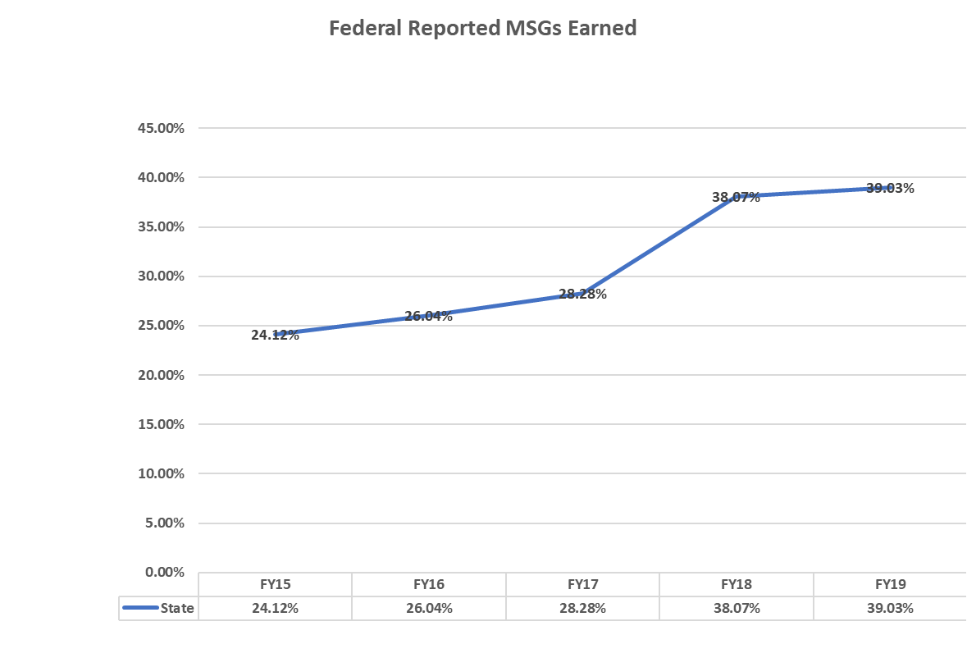
Recent Performance Outcomes
Title II: Adult Education and Literacy
Agency of Education

Slide 16
WIOA Performance Measures | PY 2017 Actual |  | PY 18 Goals | PY 18 Actual
WIOA Title I Adult
Participants Served | 282 |  |  | 275
Employment (Second Quarter after Exit) | 74.1% |  | 70.0% | 72.7%
Employment (Fourth Quarter after Exit) | 60.0% |  | 64.0% | 63.5%
Median Earnings | $ 5,045.00 |  | $ 4,530.00 | $ 6,154.00
Credential Attainment Rate | 73.8% |  | 61.0% | 64.5%
Measurable Skills Gains | 40.8 |  | baseline | 71.7%
WIOA Title I Dislocated Worker
Participants Served | 81 |  |  | 95
Employment (Second Quarter after Exit) | 89.6% |  | 78.0% | 88.9%
Employment (Fourth Quarter after Exit) | 75.6% |  | 73.0% | 78.1%
Median Earnings | $ 10,606.00 |  | $ 8,051.00 | $ 10,493.00
Credential Attainment Rate | 81.3% |  | 61.0% | 73.2%
Measurable Skills Gains | 34.5 |  | baseline | 73.9%
WIOA Title I Youth
Participants Served | 302 |  |  | 337
Employment (Second Quarter after Exit) | 62.3% |  | 50.0% | 72.4%
Employment (Fourth Quarter after Exit) | 57.1% |  | 50.0% | 59.2%
Median Earnings | $ 3,138.00 |  | baseline | $ 4,209.00
Credential Attainment Rate | 35.0% |  | 35.5% | 56.4%
Measurable Skills Gains | 20.5 |  | baseline | 52.3%
Title I: Adult, Dislocated Worker and Youth
Department of Labor

Slide 17
Title III: Wagner-Peyser
Department of Labor
¹ The drop in participants served under W-P between 2017 and 2018 are due to services provided in 2017 that no longer made the individual a participant in 2018. Referral services to partner programs or community supportive services, intake/orientation services, and the provision of labor market information are a few examples. Those individuals not considered “participants” are captured as Reportable Individuals. Reportable Individuals also include self-service only job seekers. As of 2/18/20, W-P shows 5,038 Participants and 7,400 Reportable Individuals for PY 2019.

Slide 18
In Conclusion
There are many moving parts around data collection, measurement, and performance.
A lot of data provides valuable information to inform strategies that focus attention and efforts on how to :
  Best serve Vermont’s Jobseekers and Employers
  Evaluate the effectiveness of services, supports, and programs
              THANK YOU!

