Slide 1
Economic Update Statewide Workforce Development Board Oct 2021
Mathew Barewicz
Economic & Labor Market Information Division
Vermont Department of Labor
802.828.4153
Mathew.Barewicz@vermont.gov

Slide 2
Economic & Labor Market Information Division Online at VTLMI.info
Housed in the Vermont Department of Labor
State partner to the Federal Government
100% federally funded
Thank you to the USDOL Employment & Training Administration!
Purpose: to produce, explain and disseminate economic data for the benefit of the State of Vermont, educational institutes, employers, students, job-seekers, researchers, and the general public.

Slide 3
DISCLAIMER
My opinions and my opinions alone…
…data wise, the pandemic hit at the worst possible time --- early 2020

Slide 4
2020 Census – Partial Results
We thought for a decade… ~626k
Turns out we were climbing to… +643k!!!

Slide 5
The “Great Recession” of 2007

Slide 6
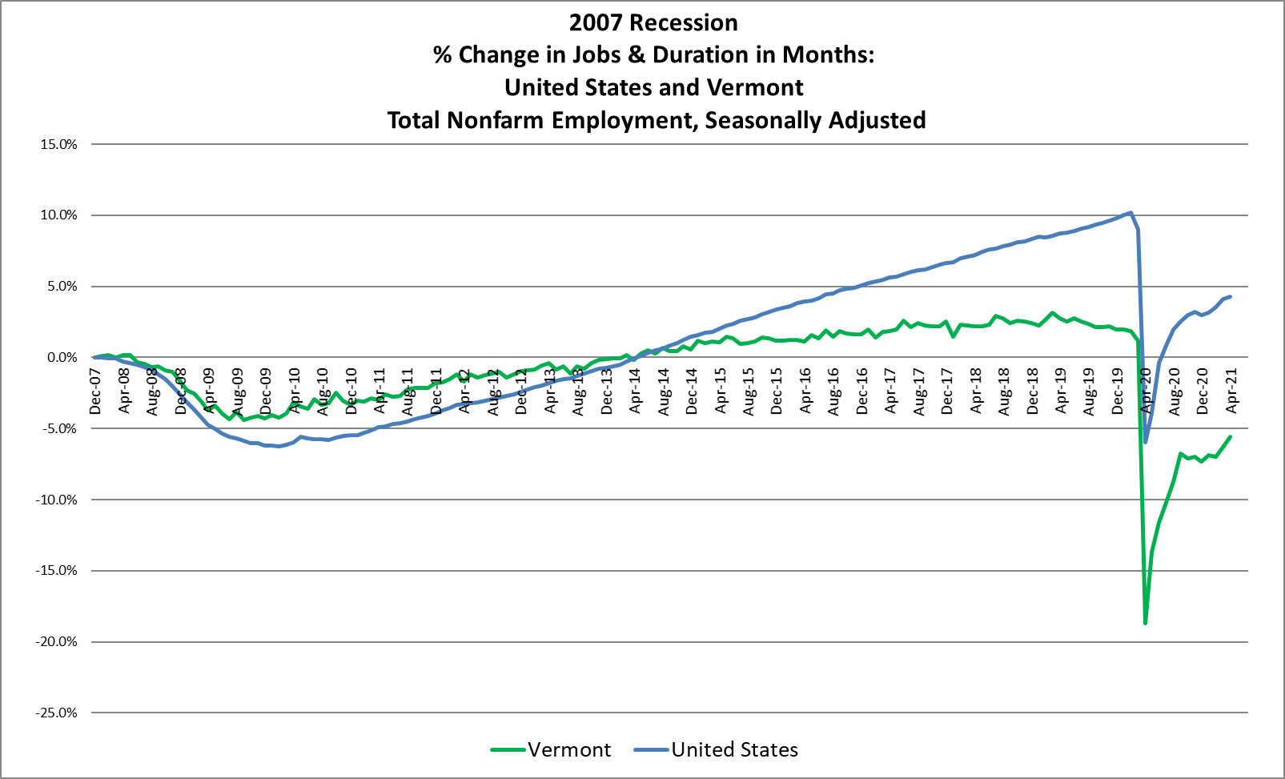

Slide 7
The COVID-19 Recession

Slide 8
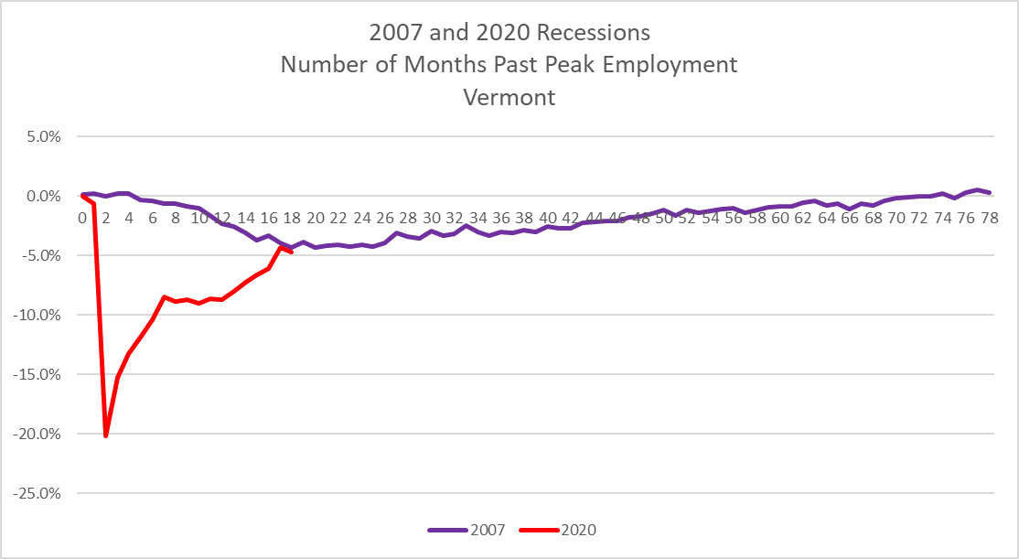
What will recovery look like?
Reader Guidance – 5% equals about 15,000 jobs
Jobs <> People… but close
Does not include structural job loss

Slide 9
The COVID-19 Recession – Sub-State
Represents a count of filled jobs; unfilled jobs not tracked here.

Slide 10
The COVID-19 Recession – Industry of Note
Represents a count of filled jobs; unfilled jobs not tracked here.

Slide 11
The COVID-19 Recession – Industry of Note
Represents a count of filled jobs; unfilled jobs not tracked here.

Slide 12
The COVID-19 Recession – Industry of Note
Represents a count of filled jobs; unfilled jobs not tracked here.

Slide 13
The COVID-19 Recession – Industry of Note
Represents a count of filled jobs; unfilled jobs not tracked here.

Slide 14
The COVID-19 Recession – Industry of Note
Represents a count of filled jobs; unfilled jobs not tracked here.

Slide 15
Local Area Unemployment Statistics (LAUS)
Bureau of Labor Statistics program
Major input into the LAUS model is data from the monthly Current Employment Survey (CPS)
The CPS is administered monthly by the US Census Bureau
The CPS is a “managed panel” survey – 1,200 Vermont households
Both the CPS and LAUS use the same definitions
Labor force…
Unemployed…

Slide 18
Labor Force Composition - Gender
Dubbed the “She”-cession
Women disproportionately impacted
Hardest hit industries
Disruptions to childcare and education
What does recovery look like for this population?

Slide 19
Labor Force Composition - Race
The growing population cohorts are non-white
Particularly among youth
The future of VT’s labor force will be greater racial and ethnic diversity

Slide 20
Labor Force Composition - Age
The earliest Baby-Boomers are turning 75 in 2021
Youth labor force participation rate has dropped!
16-19 LFPR
mid-2000s ~60%;
pre-COVID ~45%;
now below 40%

Slide 21
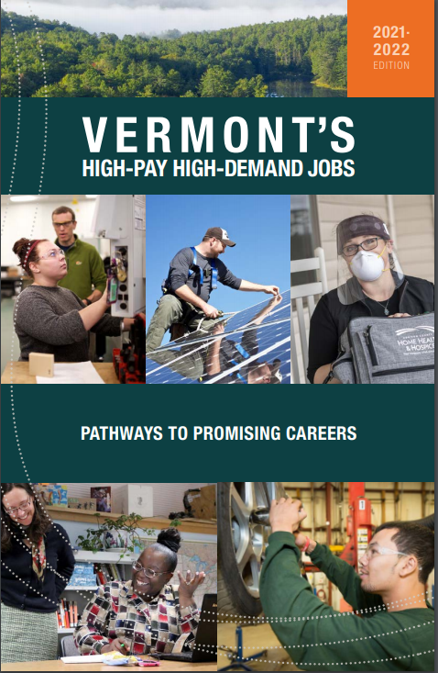
*Version 4*
A Continued Partnership with the McClure Foundation
Highlighting E&LMI Data
Found online:
VTLMI.info
in the upper right
OR McClureVT.org

Slide 22
<<< New This Edition
Found online:
VTLMI.info
in the upper right
OR
McClureVT.org

Slide 23
Labor – Know Your Market
VTLMI.info shows wage distribution by occupation
Remote work increases the competition (S/D) for labor --- sort of
Technology continues to bifurcate the labor market
Can be done remote/Can’t be done remote
Compliment/Substitute
Which industries are at greatest risk?

Slide 24
Conclusions
The “skills of yesterday” are the “skills of today”
Many of which will continue to be the “skills of tomorrow”
Show up on time
Work well with others
Follow instructions
More information leads to better decisions
VTLMI.info has a wealth of free information

Slide 25
Thank you! Provide feedback at VTLMI.info
Mathew Barewicz
Economic & Labor Market Information Division
Vermont Department of Labor
802.828.4153
Mathew.Barewicz@vermont.gov

Slide 26
Vermont’s
Workforce Development Strategies
Pre-Pandemic
Sarah Buxton
State Director of Workforce Development
Vermont Department of Labor
Sarah.Buxton@vermont.gov

Slide 27
Governor Scott’s Priority
Increase the number and skill level of available workers in Vermont.

Slide 28
State Strategies
1. Increase the Labor Participation Rate of Vermonters
2. Recruit and Relocate More Workers to Vermont
3. Assist Employers in Accessing and Retaining Qualified Workers

Slide 29
Increase the Labor Participation Rate of Vermonters
Expand Summer Youth Employment Opportunities
Support work-based learning opportunities in Vermont high schools
Create an Industry-Supported System for Developing and Recognizing Credentials and Certificates
Expand Adult Training Opportunities at Career and Technical Education Centers
Create Opportunities for Returnships
Place Employment Specialists in Vermont’s Recovery Centers
Expand Retention of Recent Vermont College Graduates
Integrate Employment and Career Resources into Personal Learning Plans (PLPs) of Adult Learning Program Participants
Continue Wrap-Around Services – including Supported Employment – for Youth Living with Mental Health Conditions. (JOBS program)
Expand Delivery of Career Counseling and Employment Services into Vermont’s Correctional Facilities.
Further Develop Career Pathways Work
Fund Early Childhood Professional Training Opportunities

Slide 30
Recruit and Relocate More Workers to Vermont
• Military Outreach
• #ThinkVermont (ACCD)
O Targeted Outreach & Recruitment Campaign (ThinkVermont.com/MOVE)
O Stay to Stay Weekends
O Social Media Campaign
O Relocation Agents
O Other Relocation Incentives
O Texting Service
O Information Exchange (ThinkVermont.com/JOBS)
• Sector-Specific Recruitment & Relocation Initiatives
• Employer-Specific Recruitment Initiatives

Slide 31
Assist Employers in Accessing and Retaining Qualified Workers
Develop Resources to Help Businesses Employ Workers with Employment Barriers
Improve Quality and Access to Vermont’s On-line Labor Exchange (JobLink)
Expand the Number of Registered Apprenticeship Opportunities
Promote Industry-Supported Training Programs
Combine Employer Outreach Efforts Across State Government to expand the Quality and Availability of Services
Expand Reach and Use of Incumbent Worker Training Programs

Slide 32
Vermont’s
Workforce Development Strategies
Now: Pandemic-Influenced
Sarah Buxton
State Director of Workforce Development
Vermont Department of Labor
Sarah.Buxton@vermont.gov

Slide 33
Governor Scott’s Priority: STILL
Increase the number and skill level of available workers in Vermont.

Slide 34
State Strategies: STILL
1. Increase the Labor Participation Rate of Vermonters
2. Recruit and Relocate More Workers to Vermont
3. Assist Employers in Accessing and Retaining Qualified Workers

Slide 35
WIOA STATE PLAN Goals and Strategies: July 2021
GOALS: (See separate handout)
Goal 1: Connect Vermonters to the education, training, and supportive services needed to enter and advance along a career pathway that leads to greater financial independence.
Goal 2: Increase the number of women, veterans, minorities, people with disabilities, and other underrepresented people employed in the skilled trades, science, technology, engineering, and mathematics fields, advanced manufacturing, and other priority industry sectors in Vermont.
Goal 3: Increase the number of Vermonters with barriers to employment who complete high school, earn a post-secondary credential - including an industry-recognized certificate, registered apprenticeship, or post-secondary degree program - and become employed in occupations that align with the needs of Vermont’s employers.
Goal 4: Improve Vermont’s workforce development system by continuously aligning, adapting, and integrating workforce education and training programs and career and supportive services to meet the needs of all customers.
Goal 5: Expand Vermont’s labor force by helping more Vermonters enter the labor market and assisting out-of-state workers in securing employment with Vermont employers and relocating to Vermont.

Slide 36
WIOA STATE PLAN Goals and Strategies: July 2021
Strategies: (See separate handout)
Strategy A: Publish and share information describing education, training, and skill development opportunities with the public and related service delivery providers in a customer-friendly format.
Strategy B: Collect and review labor market, education and training, and workforce service delivery data by gender, age, race, ethnicity, and disability status.
Strategy C: Develop common intake, communication, and referral processes to increase co- enrollment in and alignment of workforce service and support programs.
Strategy D: Develop and coordinate shared professional development opportunities, best practices, and approaches to counseling individuals in entering and advancing along career pathways.

Slide 37
WIOA STATE PLAN Goals and Strategies: July 2021
Strategies Continued: (See separate handout)
Strategy E: Increase outreach and delivery of workforce services to at-risk youth, ex-offenders, women, veterans, minorities, individuals in recovery, New Americans, individuals with disabilities, and mature workers to support their initial, continuing, and extended participation in the labor market.
Strategy F: Expand the use of progressive employment practices.
Strategy G: Prioritize participant enrollment in education and training programs that result in measurable skill gain and attainment of a high school diploma or post-secondary credential.
Strategy H: Support sector partnerships that inform the development and expansion of career pathways and alignment of education, training, and recruitment activities.
Strategy I: Assist employers in accessing and retaining qualified workers.

Slide 38
Observations and Reflections
Labor Force Supply Has Changed
Numbers, Needs, Skills, Barriers
Labor Force Demand Has Changed
Numbers, Economic & Social Priorities, Skills
Standard/Preferred Methods of Connection have Changed
Platforms, Sources, Technology
WD Development “Bucket” (Phase) Focus is shifting

Slide 39
Workforce Development Phases
Recruit
In-State
Out-of-State
Train
School (pk-12)
OJT Training
Match
Joblink
Upskill
Higher Education
Retain
Incentives
Post-Secondary
VDOL, CWS, State Partners
Independent HR and Private Recruitment
Adult CTE
Employer-Provided
Other Trainings
Workplace
Career Pathways Expansion
Incumbent Training
Industry Associations
Adult Education & Learning Providers (AEL, WIOA Title II)

Slide 40
Next Steps
Priority is to Collect and Disseminate Job Opportunities using VJL
Focus on matching jobseekers with existing jobs
Better understand changes regarding supply and demand
Apply information learned to WIOA State Plan Modification
Upgrade Virtual Employment Service Platforms
Work across Agencies and Departments to Develop and Deploy Workforce Focused Initiatives
QUESTION TO SWDB: What are the important questions you want answered by employers throughout the state? Current workers? Current Jobseekers? Those not seeking work at this point?

Slide 41
Pre & Post Pandemic Economic Recovery Programs Update
Brett Long, Deputy Commissioner
Department of Economic Development
Agency of Commerce and Community Development
10/6/2021

Slide 42
STATE STRATEGY – ACCD’s Role Pre-Pandemic
1. Increase the Labor Participation Rate of Vermonters Making strategic and coordinated investments through programs like Vermont Economic Growth Incentive (VEGI), TIF , NBRC (Northern Borders Regional Grant Program), Brownfields Revitalization Fund (BRF), to grow the economy in every region of the State.
2. Assist Employers in Accessing and Retaining Qualified Workers
Vermont Training Program: Assists employers in retaining and upskilling incumbent and new workers by providing grants for training opportunities.
3. Recruit and Relocate More Workers to Vermont
ThinkVT & ThinkVT/JOBS campaign: ACCD has a landing page and marketing effort that provides centralized information to businesses to expand/open in VT, and to individuals to relocate & stay in Vermont.
Stay-to-Stay weekends: ACCD developed and provided assistance to regions to develop weekend visits and exploratory vacations to help out of state visitors learn about moving here. Connected individuals with with employers, realtors, community leaders, entrepreneurs, and potential neighbors all while enjoying a weekend away.
Remote Worker / New Worker: 191 grantees (total), 275 family members (total), 453 total new Vermonters between both programs.
Notes:
The Agency of Commerce developed the COVID-19 Recovery Resource center as a one-stop web presence for businesses to access information regarding sector guidance for closures & reopenings, and in our recovery phase – for recovery resources. This portion of our website is updated in real-time, and we encourage everyone to continue to utilize it as a resource for information.

Slide 43
Timeline of Vermont’s State of Emergency
On March 13, 2020, Governor Phil Scott declared a state of emergency to help ensure Vermont has all the necessary resources to respond to the COVID-19 public health emergency.
On March 24, 2020, Governor Scott issued a “Stay Home, Stay Safe” order and directed the closure of in-person operations for all non-essential businesses (effective March 25-May 15, 2020).
On May 15, 2020, Governor Scott signed Addendum 14, a Be Smart, Stay Safe order to extend the State of Emergency to June 15, 2020 and update previous emergency orders to reflect re-openings and eased restrictions.
On June 14, 2021, Governor Scott ended all COVID-19 Restrictions

Slide 44
COVID-19 & ACCD’s Emergency Response
ACCD’s role and mission has always been to promote the growth of Vermont’s economy and communities; helping both businesses and communities thrive and flourish.
The pandemic temporarily changed that mission:
Once the State of Emergency was announced, ACCD was responsible for communicating with businesses about guidance around required closures.
Immediately created the Governor’s Economic Emergency Mitigation and Response team internally – which included three Action Teams:
Business Financial and Technical Support SWAT
Local and Community Solutions SWAT
Stay Home, Stay Safe & Economic Transition SWAT
ACCD spearheaded safe re-opening and restart plans with nearly every single sector – both helping create restart plans and helping businesses navigate guidance that was being updated frequently.
Once re-opening (“Be Safe, Be Smart”) plans were deployed, ACCD created and deployed recovery programs to respond to financial needs and economic hardship of businesses.
Focus was financial support for businesses, and support for local communities to help mitigate spending and purchasing habit changes.
Notes:
The Agency of Commerce developed the COVID-19 Recovery Resource center as a one-stop web presence for businesses to access information regarding sector guidance for closures & reopenings, and in our recovery phase – for recovery resources. This portion of our website is updated in real-time, and we encourage everyone to continue to utilize it as a resource for information.

Slide 45
Economic Recovery Grants: 1.0 & 2.0 Data & ECONOMIC Impact ACCD prioritized providing additional emergency assistance to businesses to help them sustain through the impacts of mandatory closures ana phased-in re-opening. Full Report
4,856
Businesses received
$330,052,379
25% of recipient organizations were Food and Accommodation businesses. They had the greatest unmet need ($257,492,287) and received 42% of the proceeds.
14% of the recipients were in the hard hit Retail Trade sector. These awards accounted for 12% of the total
53%
of recipients
(2,608) had 4 or
less employees.
86% of recipients (4,198) had revenues of $1.5 million or less in 2019
.
34%
of awards were made to WBE or MBE recipients
.

Slide 46
ACCD created the Small Business Recovery Technical Assistance Program to provide recovery services to small businesses Full Report
In total, these five organizations:
• Used 305 technical assistance providers to help in a wide range of pandemic recovery services: and
• Delivered contracted services totaling $1,902,330 in value to 554 Vermont businesses with more than 7,000 employees: and
• Provided several webinars that allowed for even more businesses to gain access to information for improving business service delivery.

Slide 47
STATE STRATEGY – ACCD’s Role “Post”-Pandemic
Our GOALS remain the same, but are in some ways MORE CRITICAL.
1. Increase the Labor Participation Rate of Vermonters
Not in emergency, but there are lingering impacts as Labor outlined.
Continue making strategic and coordinated investments through our programs with the addition of a Capital Investment Grant program, a state-sponsored (general fund) Brownfields program.
Create and deploy the Economic Recovery Bridge Program that provides gap funding for businesses who had not received state or federal funding previously, and/or who did not receive adequate funding previously.
2. Assist Employers in Accessing and Retaining Qualified Workers
Continue to promote and expand the Vermont Training Program as a tool for employers to upskill incumbent and new workers.
3. Recruit and Relocate More Workers to Vermont
New relocation program that offers reimbursement grants, up to $7,500, to workers across the country who move to Vermont after July 1, 2021.
New “Remote Worker” program will offer grants to individuals who move here to work in January of 2022.
Notes:
The Agency of Commerce developed the COVID-19 Recovery Resource center as a one-stop web presence for businesses to access information regarding sector guidance for closures & reopenings, and in our recovery phase – for recovery resources. This portion of our website is updated in real-time, and we encourage everyone to continue to utilize it as a resource for information.

Slide 48
NEW: Economic Recovery Bridge Program - $30M
Application window opened for businesses who had not received prior assistance (state or federal) on June 7. APPLICATION IS STILL LIVE.
On July 7, per statute, application window opened for businesses who had received prior assistance, and who could also show a net-tax loss for 2020.
Program Summary
$1.9 Million (79 awards)
At least one award in every county except Essex County
Average award amount is $24,201
77% of applications received have not been completed
122 businesses applied, and were ineligible
NAICS Industries with most per award amount: Accommodations, Ag & Manufacturing
Most NAICS industries per application: Accommodations, Retail, Ag
*Data as of 10/6/2021

Slide 49
NEW: Capital Investment Grants - $10.580M
APPLICATION IS LIVE.
The purpose of the program is to make funding available for transformational projects that will provide each region of the State with the opportunity to attract businesses, retain existing businesses, create jobs, and invest in their communities by encouraging capital investments and economic growth.
The Governor’s Recovery Plan is focused on transparent investments in key infrastructure needs including housing, broadband, wastewater, and sewer systems, climate change prevention and mitigation, and economic development.
The transformational projects are those that have impacts beyond the immediate economic impacts of job and wage growth directly associated with the investment. These additional impacts can include regional impacts on workforce development, or supply chain improvements, adding stability to local areas with fragile economic conditions , a sector-wide impact that other businesses will be able to benefit from.

Slide 50
NEW: Relocated Worker Grant Program
New relocation program that offers reimbursement grants, up to $7,500, to workers across the country who move to Vermont after July 1, 2021.
This new program builds upon Vermont’s previous successful recruitment initiatives and aims to attract new residents to the state, grow the workforce, and support employers facing workforce challenges due to low unemployment or finding qualified candidates.
This latest iteration of the program will be available to those who relocate to Vermont, on or after July 1, 2021, and fill a qualifying position with a Vermont employer.
COMING IN 2022 - Remote worker grants will be available to those who relocate to Vermont, on or after February 1, 2022 and work remotely from within Vermont for an out-of-state employer.

Slide 51
NEW: Relocated Worker Grant Program – GRANT RESOURCES
Worker Relocation Grant FAQs List of frequently asked questions, as well as application readiness information for employers and applicants.
Short Term Occupational List (Eligibility Requirement)
Eligible applicants must be employed in an occupation identified on the Short Term Occupational List as curated by the Department of Labor and the Bureau of Labor Statistics. The Agency of Commerce no longer as the authority to offer exclusions or waivers from this list.
Relocated Worker Grant Program Application
Employers can direct applicants to the Agency of Commerce’s website to complete the application. Please review all materials prior to applying to determine eligibility. Applicants will also be able to view application status on our webpage.
CONTACT: Kristen Ziter, Program Director Kristen.ziter@vermont.gov

Slide 52
2018 & 2019 New Worker Program & Remote Worker Program
REMOTE WORKER (2018)
Full Report
140 Grantees
229 Family members (which includes 78 children)
369 New Vermonters (plus two indicated babies on the way)
NEW WORKER PROGRAM (2019)
Full Report
51 Grantees
46 Additional Family Members (includes 17 children)
84 New Vermonters
The first two bullets represent only 38 of the 51 grantees who had completed the demographic survey to date

Slide 53
The future of the State Workforce Development Board
Executive Director, Tori Biondolillo

Slide 54
INTRODUCTIONS
Victoria Biondolillo
Executive Director
Born and Raised in Barre, VT
BCK Real Estate
University of Vermont, B.A. Business
Governor Scott Internship & Position
New Role
Phone: 802-839-6221
Email: Victoria.Biondolillo@vermont.gov
Intro
Overview
The Future
Comms
Vision
Compliance
One-Stop
Network
Objectives

Slide 55
Overview
Where are we now?
Where are we headed?
How are we going to get there?
Intro
Overview
The Future
Comms
Vision
Compliance
One-Stop
Network

Slide 56
Vision
Short-Term
Use strategies, communication, and collaboration to connect Vermonters to jobs quickly.
Recruit through training or employment out-of-state individuals looking to relocate
Long-Term
Engage with Vermont’s youth Earlier
Creating Career pathways starting in Middle School
Marketing Vermont Businesses as the number
Intro
Overview
The Future
Comms
Vision
Compliance
One-Stop
Network
Objectives

Slide 57
Objectives
Federal Compliance
Effective One-Stop Operator
Workforce Development Communication Network
Advertise, market and package Vermont businesses, regions, and sectors to the rest of the country.
Make the State Workforce Development Board THE place to get all connected to one-stop services.
Intro
Overview
Vision
Objectives
Compliance
One-Stop
Network
Comms
The Future

Slide 58
Federal Compliance
MOU Negotiations
RFP for One-Stop
SWAYS Planning
Intro
Overview
The Future
Comms
Vision
Compliance
One-Stop
Network
Objectives

Slide 59
One-Stop Operator
Approval Process
Objectives & Metrics
Role of the Board in Evaluation Process
Intro
Overview
The Future
Comms
Vision
Compliance
One-Stop
Network
Objectives

Slide 60
Network & Policy Process
Regional
Sector
Intro
Overview
The Future
Comms
Vision
Compliance
One-Stop
Network
Objectives

Slide 61
Communications & Marketing
Goals & Objectives
Utilization of the Network
Email Communications
Coordination with Tourism & Marketing
Social Media
Intro
Overview
The Future
Comms
Vision
Compliance
One-Stop
Network
Objectives

Slide 62
Moving Forward
You’ll Deliver:
Open and Honest Communications
All Ideas on the Table
Tapping into your Sphere of Influence
Involvement and Engagement throughout the year.
We’ll Deliver:
Consistent and regular communication
Asking More Questions
Proactive Scheduling, Policy, and Leg. Updates
Creation and Implementation of the Network and communications Structure
Monitoring and Data for your oversight into our progress.
Intro
Overview
The Future
Comms
Vision
Compliance
One-Stop
Network
Objectives

