Slide 1

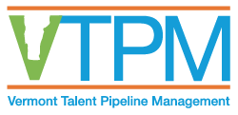
Mary Anne Sheahan
Executive Director

Slide 2
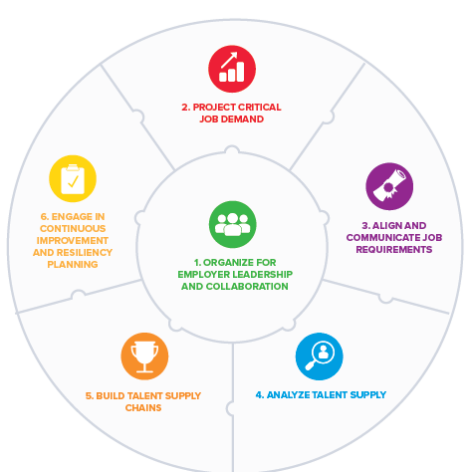
What is
Talent Pipeline Management?
A set of STRATEGIES and RESEARCH TOOLS to align training to industry careers
Uses industry best practices
Plans for future jobs and careers
Represents employer demand, authentically
Produces collective action and decision-making
* TPM is developed by the US Chamber of Commerce Foundation

Slide 3
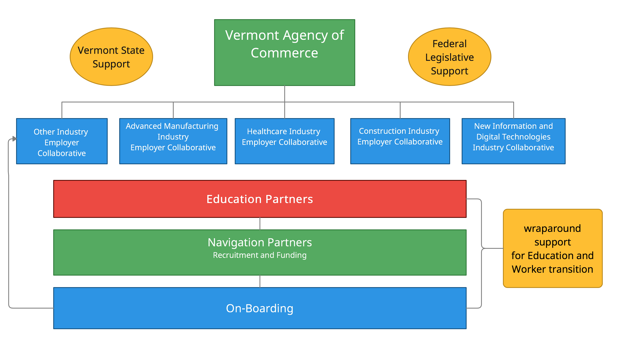
A SHARED VISION FOR VTPM

Slide 4

HEALTHCARE
CHALLENGES
  13% of Vermont jobs 2021
  >6% fewer workers from Nov19-Nov21
  Frontline exhaustion and burnout
  $123+ million for travelers in 2021
  1 in 7 qualified nursing applicants accepted at VTC Williston
Of the 6,244 nursing vacancies forecasted by 2023 (N=43, Avg=145)
    42% for Registered Nurses
    24% for Nurse Assistants
    30% new, for industry growth
POTENTIAL SOLUTIONS
    + Invest in clinical educators and faculty to build capacity
    + Utilize apprentice nurses to fill nurse assistant roles, while training for Registered Nurse
    + Provide wraparound support for participants in training and transition to work (childcare and housing)

Slide 5
CHALLENGES
9% of workforce in 2020
>6% decline between Nov19 and Nov21
2193 job vacancies forecasted by 2023, 46% for anticipated growth (n=45, avg=49)
POTENTIAL SOLUTIONS
Apprentice – work and receive related instruction; with skill and wage increases
+ Certified Production Technician
+ CNC Machinists
Exploring Careers events for participants
CHALLENGES
5% of workforce in 2020
GC shortages from craft to management
+ Support trades and subcontractors
POTENTIAL SOLUTIONS
Targeted CTE investments
+ Adult programming
+ Regional outreach
+ Wraparound support
Apprentice carpentry and trades
Exploring Careers events for participants
MANUFACTURING
CONSTRUCTION

