Slide 1
Workforce Education at CCV

Slide 2
Community College of Vermont
Classes offered in 12 locations statewide and online
Associate degrees: 11
Career Certificates: 22
Associate and/or Certificate Programs that are available 100% online: 26
Accredited since 1975 by the New England Commission of Higher Education
Admission: open to all students who can benefit
Credits transferable to bachelor’s programs
Awarded in AY 2021
Associate and associate of applied sciences degrees: 420
Career-focused certificates: 91
Industry-recognized credentials: 179
Number of part-time faculty: 455
Number of staff: 156

Slide 3
Our Students
Attending fall ’21 semester: 5,987
Attending CCV each year (3 semesters): 9,770
Vermonters: 93%
Average age: 27
Dual Enrollment – Taking courses for college credit while still in high school: 1,871
Female: 70%
Self-identified member of minority racial or ethnic group category other than white or non-Hispanic: 14%
Seeking degrees: 59%
Degree students with full- or part-time jobs: 79%
Degree students enrolled part-time: 82%
Degree students enrolled full-time: 18%
First generation in their family to attend college: 55%
Degree students receiving a Pell Grant: 46%
Graduates since 1973: 13,705
Graduates (Class of ‘18) who reported being employed, continuing their education, or serving in the military within 6 months: 95%

Slide 4
Workforce Education at CCV
Industry Recognized Credentials
Trainings and Courses
Registered Apprenticeship
Certificate Programs and Degrees

Slide 5
Industry Recognized Credentials
Some examples of IRCs available at CCV include:
Association of Rehabilitation Educators (ACRE)
National Association of Public Bookkeepers (NACPB)
Certified Production Technician (CPT)
Students can also take training that can lead to an IRC, such as:
Pharmacy Tech Certificate (leads to the PTCB)
Medical Assisting Program (leads to the CCMA)
A verification of an individual’s qualifications or competencies, issued by a third party with the relevant authority to issue such credentials. (USDOL)

Slide 6
Industry Recognized Credentials by Industry
Health and Human Services
Employment Services (ACRE)
Certified Addiction Professional (CAP)
Certified Medical Assistant (CCMA)
Certified Pharmacy Technician (CPhT)
Manufacturing
Certified Production Technician (CPT 4.0)
Green Production
Professional Studies
Bookkeeping
Accounting
Payroll
QuickBooks
Technology
Software Development
UX/UI Design
Certified Cloud Practitioner
Certified Solution Architect Associate
CompTIA
Safety
Quality Processes
Maintenance
Certified Customer Service Experience Professional

Slide 7
Registered Apprenticeship
Registered Apprenticeship is an employer-driven model that combines on-the-job training with job related instruction, which progressively increases an apprentice’s skill level and wages.
Apprenticeship offers an industry-proven approach for preparing workers for careers while meeting employers’ need for a highly-skilled workforce.
Traditionally, apprenticeship programs were primarily associated with construction and other skilled trades. Apprenticeships are now expanding into several other industries.

Slide 8
Apprenticeship Components
Business Involvement
Structured On-the-job Training
Related Instruction
Rewards for Skills Gains
Nationally Recognized Credential

Slide 9
Registered Apprenticeships at CCV
Manufacturing Production Technician
Pharmacy Technician
Medical Assistant
Pre-apprenticeship in Nursing
Certified Public Bookkeeper

Slide 10
Combining Businesses with Apprenticeship
Privately owned by the Perkins family since 1965, Orvis is headquartered in beautiful Southwestern Vermont with major operations in Roanoke, Virginia, and the United Kingdom. Today Orvis is an international, multi-channel retailer with approximately 1,500 US employees. At our core, we are a fly-fishing and wingshooting brand, inspired by nature, driven by curiosity, and fulfilled by adventure.
Also family owned, Darn Tough has been knitting socks here in the Green Mountains for close to 40 years. Darn Tough is three generations strong and knows how to make socks. Crafting the world’s most comfortable, durable, and best fitting socks is an ardent skill passed down from father to son. This commitment, this passion, it’s in the blood.

Slide 11
Train and Retain with Pre-Apprenticeship
Central Vermont Medical Center is the primary health care provider for 66,000 people who live and work in the 26 communities of central Vermont.
CVMC is using a “Train and Retain” strategy to grow their nursing workforce from current Licensed Nursing Assistants.
17 LNAs have been taking prerequisite courses at CCV since summer and will enter VTC’s nursing program in the fall.
These courses are a pre-apprenticeship that leads directly to an apprenticeship in nursing.
A “Grow your Own” strategy is used to train and retain the current workforce so they can be upskilled for higher positions

Slide 12
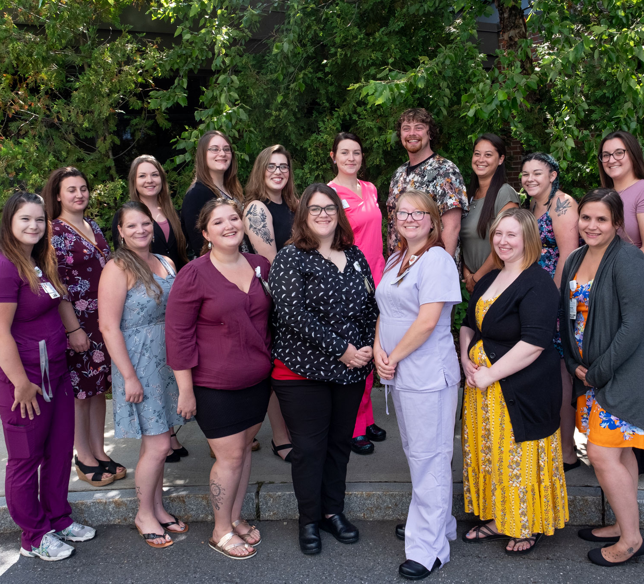
Healthcare Partnerships: CVMC
LNAs at Central Vermont Medical Center celebrating the kick-off of their journey to becoming LPNs through a new partnership between CVMC, CCV, and Vermont Tech.

Slide 13
Healthcare Partnerships: BMH

Slide 14
Pharmacy Technician Program
CVS Health is the largest pharmacy healthcare provider in the United States. CVS asked CCV to develop a Pharmacy Technician Apprenticeship to create a new pipeline of Pharm Techs.
CCV developed a new Intro to Pharmacy course, taught by a pharmacist and faculty member from Albany College of Pharmacy.
In order to reach Vermonters across the state, the course is offered online with weekly live webinars.
In fall 2020, CCV launched a new Pharmacy Technician Certificate Program, which is imbedded in our Health Science Degree.

Slide 15
Weekly Live Webinars (Synchronous Online learning)

Slide 16
Pipeline of New Workers: UVMHN

Slide 17
Nested Programming
Health Science Associate Degree
60 Credits
Variety of courses from several disciplines
Pharmacy Tech Certificate
8 Courses
24 College Credits
Pharmacy Tech Apprenticeship
3 Courses
On-the-Job Training
9 College Credits

Slide 18
Grants and Contracts
The CCV Workforce Education Department seeks out, writes, and manages several grants each year, and partners on grants with other organizations and businesses.
Large Federal Grants such as TAACCCT
Apprenticeship Grants
State Grants such as WETF and other VDOL grants
Workforce 1.0, 2.0
Local Grants/Philanthropy
Vermont Training Program Grants
Contracts with businesses, organizations and state entities

Slide 19
Coronavirus Relief Funds in Action
$3 Million to support Vermonters whose work was negatively affected by the pandemic
Participants could take up to 2 courses or workshops across the Vermont State Colleges
1,145 Vermonters enrolled in over 2,000 courses
Just under $630,000 was also awarded for supportive services such as childcare, textbooks and other expenses.

